Slide 1
Intracranial EEG
Learning by Hidden Markov Model
datasciencelab.ca
Ashok Bhowmick
May 31, 2019
Toronto

Slide 2



Slide 3
Outline
EEG: Extracranial vs Intracranial
The Data set
HMM as an approach and why?
Codes and Results

Slide 4
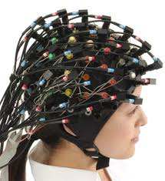
EEG → a recap

Slide 5
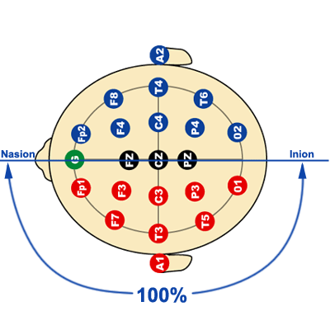
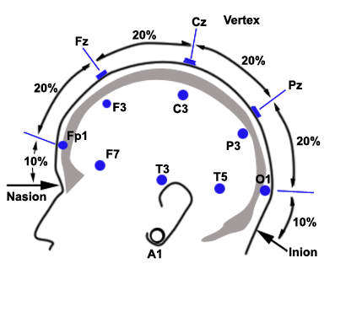
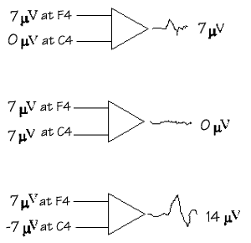
Electrode arrangement →
International 10×20 system
Reference derivation

Slide 6
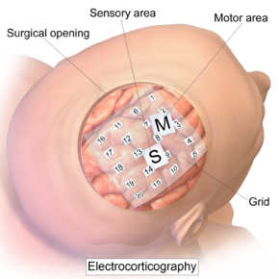
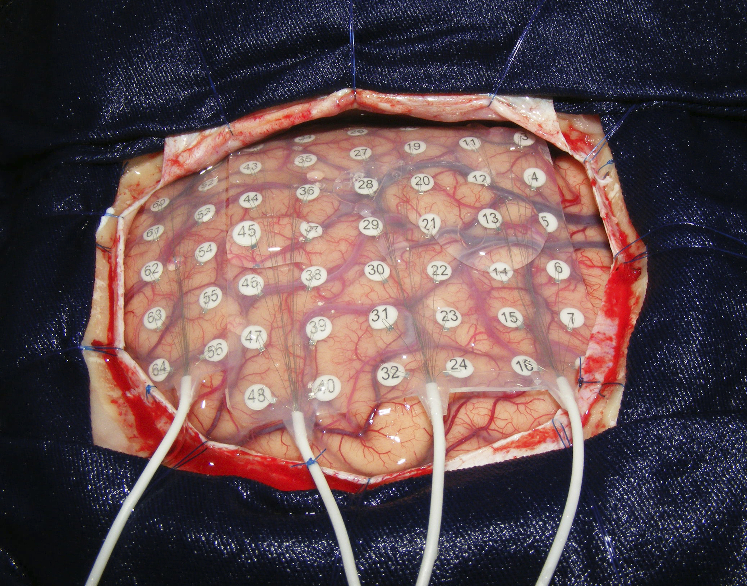
Intracranial (iEEG)

Slide 7
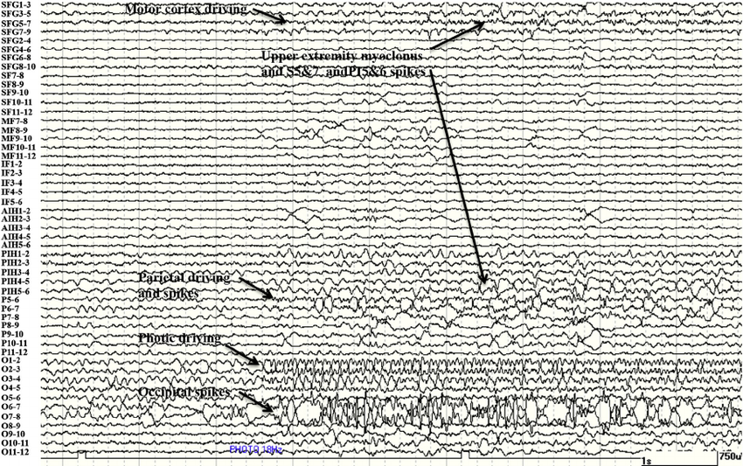
Typical raw data corpus
Visual Inspection:
Is still regarded as the most important in clinical decision making
Two neurologists who are board-certified electroencephalographers.

Slide 8
The iEEG Data set
Origin: Bern University Hospital, University of Bern, Switzerland
Currently uploaded in Bern-Bercelona EEG database, Spain
Subjects: 5 patients with longstanding pharmaco-resistant temporal lobe epilepsy Candidates for surgery
Arrangement: 2 sets of measurements designated as Focul or F-series and
Nonfocul or N-series
F-series data are from epileptic (or tumor) zone : the epicenter
N-series data are from the healthy (or neutral) part of the brain
Structure: Paired data, designated as set X and set Y. 750 files of each type per
patient; total (3750 × 2) = 7500 files
Sampling: 512 Hz
Time span: 20 Sec. i.e. 10240 instances in each file
Corpus size: 76.8 million

Slide 9
EEG difficulties:
High dimensionality, Large or sparse sample size, low SNR, Non-stationarity
Noise infection:
Primary source of noise:
Electrode movement reflected as shift in vertical scale
Line Noise
Swinging
Therefore,
All signals are band-pass filtered
Phase distortions are minimized by forward-backward filtering

Slide 10
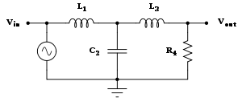
Noise reduction → Butterworth Filter
Butterworth filter is maximally flat
Frequency response has no ripples in the passband and
Rolls off towards zero in the stopband.^{[2]}
A 3rd-Order low-pass filter where,
C₂ = 4/3 Farad, R₄ = 1 Ohm, L₁ = 3/2 Henry, and L₃ = 1/2 Henry,
becomes a Butterworth filter with
Cutoff frequency, ω_{c} =1
The data is filtered using a fourth-order Butterworth filter
Cutoff Frequency range = 0.5 to 150 Hz

Slide 11
Parameter description
x (F) measures
y (F) measures
epilepsy
zone,
F-series data
y (N) measures
healthy
zone,
N-series data
Opening on skull
x (N) measures
Data files →

Slide 12
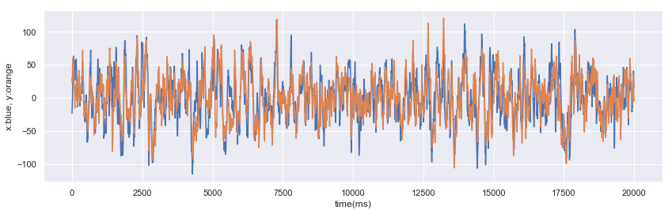
x and y measures w.r.t. time (F-series)

Slide 13
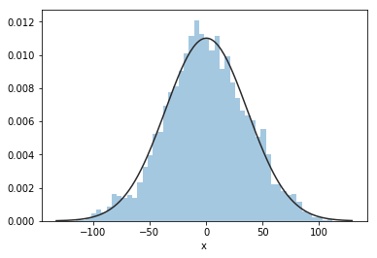
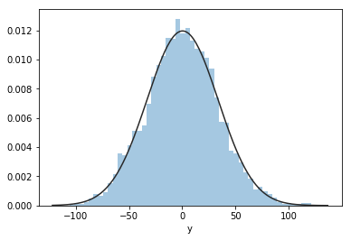
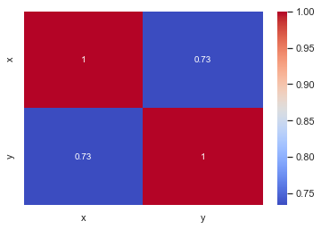
x and y measures distribution (F-series)
RMSE = 22.7
← not linear ?

Slide 14
Modern understanding of Epilepsy:
It is related to hypersynchronous activity of networks of neurons in brain
Acute seizures are extreme manifestation of this hypersynchronous activity
An elevated level of interdependence of neuronal dynamics persists even during seizure free interval
Hypothesis:
Hypersynchronous activity is the source of ions that generates the signal
Assuming, one affected brain has one type of characteristic interdependence, it is pertinent to integrate the bivariate pairs, so that features can develop at specific time-stamps, if any. (analogy: mass spectrometry)
If so, the difference between the bivariate pairs should be an equivalent measure of the interdependency. (analogy: travelling pressure wave in seismic events)

Slide 15
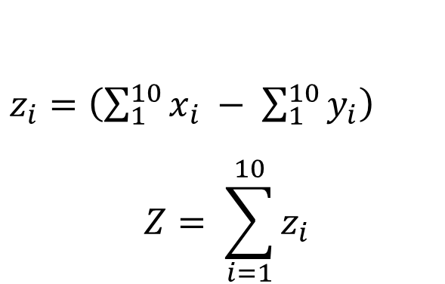
Scheme : Difference Wave
$z_{i}=$ $\left(\sum_{1}^{10}{x_{i}} − \sum_{1}^{10}{y_{i}}\right)$
$$Z= \sum_{i=1}^{10}{z_{i}}$$
Thereby, z’s are the new data to apply ML tools,

Slide 16
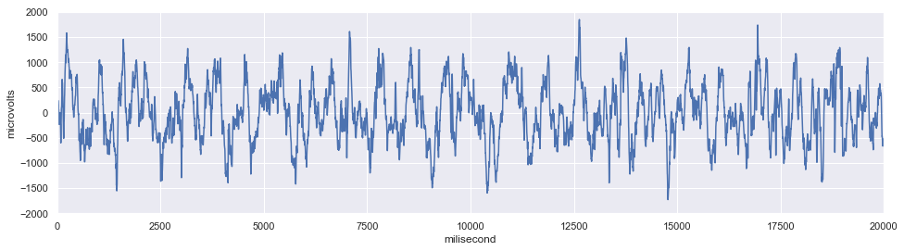
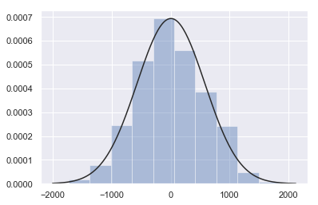
Integrated difference wave: High S/N ratio, Reduced dimension
Distribution does not change

Slide 17
To add value to understand the root cause of seizure
Research Questions :
Is it possible to regenerate or replicate specific Epileptoform of a patient using machine learning algorithm?
Can this compare to the statistical performance of surrogate data ?

Slide 18
Applying
Hidden Markov Model

Slide 19
Unsupervised Learning Approach
Bayesian Machine Learning: Hidden Markov Model
A Markov chain (model) describes a stochastic process where the assumed probability of future state(s) depends only on the current process state and not on any the states that preceded it (shocker).
The Hidden Markov Model (HMM)
A generative probabilistic model.
A sequence of observable X variables is generated by a sequence of internal hidden states Z.
The hidden states are not observed directly.
The transitions between hidden states are assumed to have the form of
a (first-order) Markov chain.

Slide 20
Perspective
Getting targets when modeling sequences
• When applying machine learning to sequences, we often want to turn an input
sequence into an output sequence that lives in a different domain.
– E. g. turn a sequence of sound pressures into a sequence of word identities.
• When there is no separate target sequence, we can get a teaching signal by trying
to predict the next term in the input sequence.
– The target output sequence is the input sequence with an advance of 1 step.
– This seems much more natural than trying to predict one pixel in an image
from the other pixels, or one patch of an image from the rest of the image.
– For temporal sequences there is a natural order for the predictions.
• Predicting the next term in a sequence blurs the distinction between supervised
and unsupervised learning.
– It uses methods designed for supervised learning, but it doesn’t require a
separate teaching signal.
Ref: Prof. Hinton, Lecture in ML course (UoT)

Slide 21
Ref: Prof. Hinton, Lecture in ML course (UoT)

Slide 22
Ref: Prof. Hinton, Lecture in ML course (UoT)

Slide 23
Domain of Kalman Filtering
Ref: Prof. Hinton, Lecture in ML course (UoT)

Slide 24
Adopted the term ‘hidden’ for neural net
Ref: Prof. Hinton, Lecture in ML course (UoT)

Slide 25
Ref: Prof. Hinton, Lecture in ML course (UoT)

Slide 26
Ref: Prof. Hinton, Lecture in ML course (UoT)

Slide 27
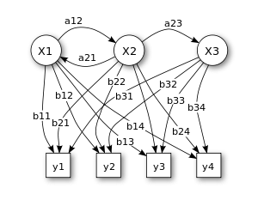
HMM →
X — states y — possible observations a — state transition probabilities b — output probabilities

Slide 28
HMM can be specified by:
The start probability vector π
Transition probability matrix A.
The emission probability of an observable can be any distribution with parameters θ depending on the current hidden states.
HMM is completely determined by π, A, θ
__________________________________________________________________________

Slide 29
There are three fundamental tasks in HMMs:
1. Given just the observed data, estimate the model parameters
Can be solved by an iterative Expectation-Maximization (EM) algorithm, known as the Baum-Welch algorithm
2. Given the model parameters and observed data, estimate the optimal sequence of hidden states
3. Given the model parameters and observed data, calculate the likelihood of the data
Can be solved by dynamic programming algorithm known as Viterbi algorithm

Slide 30
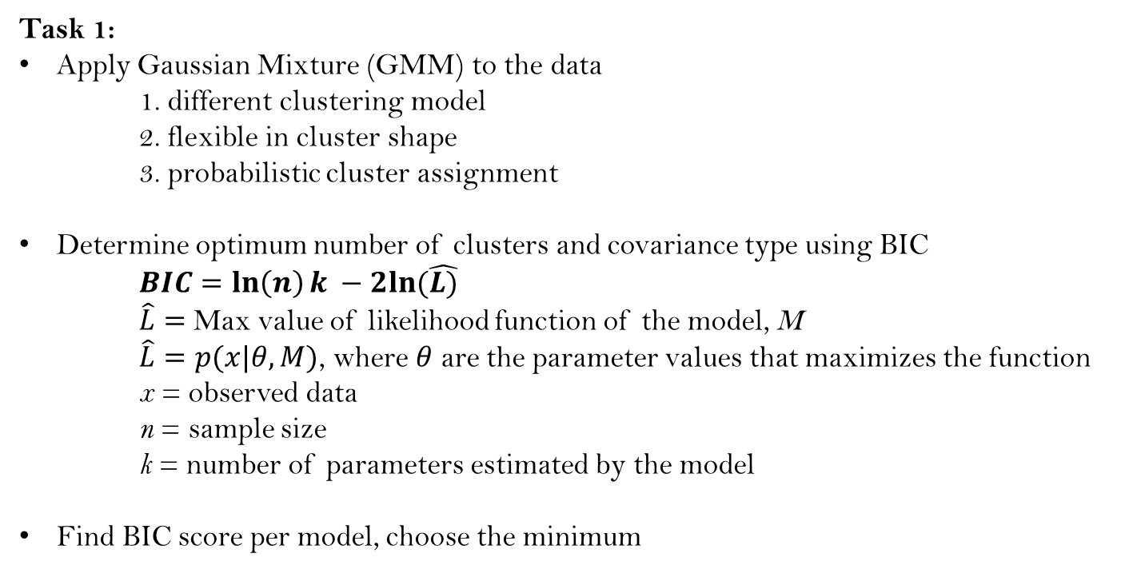
Task 1:
Apply Gaussian Mixture (GMM) to the data
1. different clustering model
2. flexible in cluster shape
3. probabilistic cluster assignment
Determine optimum number of clusters and covariance type using BIC
$BIC=\ln\left(n\right)k −2ln⁡(\hat{L)}$
$\hat{L}=$ Max value of likelihood function of the model, M
$\hat{L}=p(x|θ,M)$, where $θ$ are the parameter values that maximizes the function
x = observed data
n = sample size
k = number of parameters estimated by the model
Find BIC score per model, choose the minimum

Slide 31
Task 2 and 3:
Component of minimum BIC score is taken as number of hidden components at same covariance type, which controls the degrees of freedom in the shape of the clusters
Apply Bayesian statistic using ‘BayesianGaussianMixture’ to determine the probabilities with ‘Dirichlet distribution’ as weight_concentration_prior_type
This assumes that prior is the conjugate prior for the likelihood function
Bayesian posterior distribution: $P(θ|X)=\frac{P\left(X | θ\right)P(θ)}{P(X)}$
Likelihood function, P(X|θ), fixed by model ; prior, P(θ), our choice; P(x), fixed by data
BIC →
Where, π(θ|M) is the prior for θ under model M

Slide 32
Fit data with HMM model with calculated number of components, covariance type and probabilities from the data
Training use Gradient optimization
hmm.GaussianHMM (components + covariance type + probabilities) | Hidden Markov Model with Gaussian emissions.
hmm.GMMHMM (components + covariance type) | Hidden Markov Model with Gaussian mixture emissions.
hmm.MultinomialHMM (for custom emission probabilities like Poisson) | Hidden Markov Model with multinomial (discrete) emissions
Note: explain thru codes,

Slide 33
References:
Lawrence R. Rabiner “A tutorial on hidden Markov models and selected applications in speech recognition”, Proceedings of the IEEE 77.2, pp. 257-286, 1989.
Jeff A. Bilmes, “A gentle tutorial of the EM algorithm and its application to parameter estimation for Gaussian mixture and hidden Markov models.”, 1998.
Andrzejak R G, Schindler K, Rummel C., Nonrandomness, nonlinear dependence, and nonstationarity of electroencephalographic recordings from epilepsy patients, Phys. Rev. E, 86, p. 046206, (2012)
Thomas Schreiber, Constrained Randomization of Time Series Data, Phys. Rev. Lett., 80(10) p. 2105 (1998)
R. G. Andrzejak, D. Chicharro, K. Lehnertz and F. Mormann, Using bivariate signal analysis to characterize epileptic focus: the benefit of surrogates
Gaussian Mixture Modelling: https://towardsdatascience.com/gaussian-mixture-modelling-gmm-833c88587c7f
Blei, D.M., Ng, A.Y, Jordan, MI (2003) Latent Dirichlet Allocation. Journal of machine Learning research, 3(Jan), pp.993–1022.
Bayesian Methods for Machine Learning, Coursera Course.
Thanks for listening
datasciencelab.ca

Slide 34

Note on Dirichlet or Multivariate beta distribution
Dirichlet is a family of continuous multivariate probability distribution parameterized by α vector a of positive reals
It is multivariate generalization of Beta distribution
It is commonly used as the prior distribution in Bayesian statistics, as it is the conjugate prior of a number of important probability distributions
If we observe n dice rolls, restricted to only 1, 2, and 3, then the likelihood function is given by,
where, N_{k} is the number of time the value k€{1, 2, 3} occurs
Ref: ISBN 978-0-471-18387-7 (Chapter 49)

